Slide 1

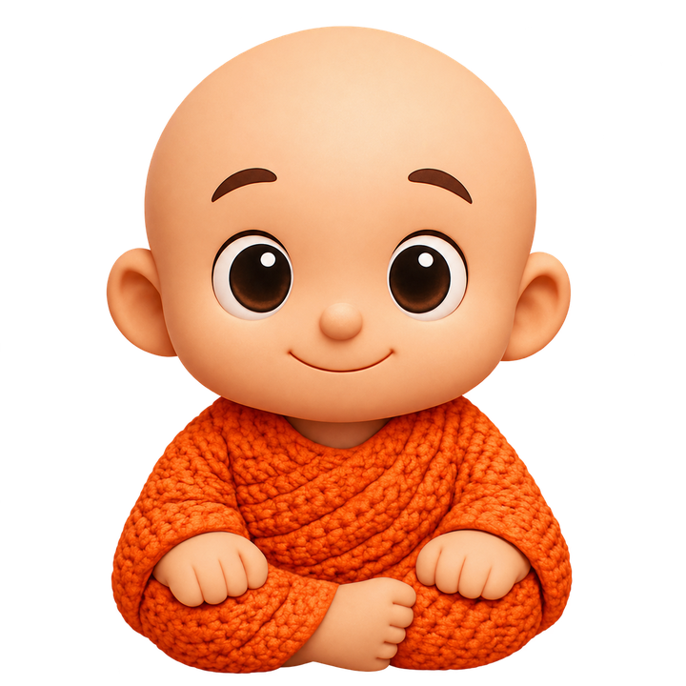
knodd.au 01
the approving friend
by your side.
Wardrobe & product vision
18 October 2026
Notes:
Source: KNODD Living Branding Document v1.1, 13 January 2026. https://docs.google.com/document/d/1gcATUOFbaDA3XCJLDBvEaDbEUFzYdwd0/edit. Current founder instructions, 18 October 2026, supersede old brand relationship, fused-body architecture and palette. Original character and wordmark artwork supplied by founder. Public concept presentation. No funding ask, traction or launch date claimed.

Slide 2
knodd.au 02
KNODD's wardrobe tool
Explore a look for the same little friend.
Choose a colour
Explore a wardrobe direction through colour previews.
Try a texture
Compare fabric concepts and express a preference.
Keep the character
The familiar face stays at the centre of each look.
Visual concepts. Final garments still need design, material and fit validation.
Notes:
Source: KNODD Living Branding Document v1.1, 13 January 2026. https://docs.google.com/document/d/1gcATUOFbaDA3XCJLDBvEaDbEUFzYdwd0/edit. Current founder instructions, 18 October 2026, supersede old brand relationship, fused-body architecture and palette. Original character and wordmark artwork supplied by founder. Source: current founder correction,18 October 2026: KNODD is a broader character and clothing brand that can use manufacturing; the wardrobe tool leads and 3D printing is only an optional studio service. Earlier supplied studio branding documents inform optional portfolio directions. No manufacturer, factory, quotation, minimum order quantity, completed samples, rights or certification is assumed. The recovered business plan is an unfilled template, not evidence of operating results.

Slide 3
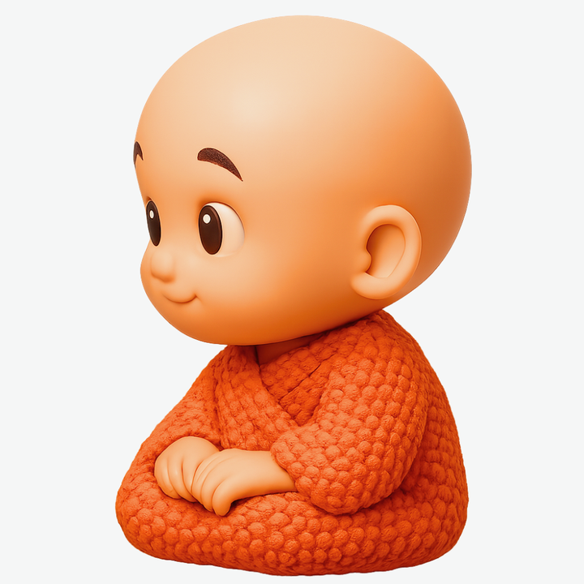
knodd.au 03
Meet KNODD
A familiar little face.
A gentle nod of approval.
KNODD is a physical character concept with an articulated head and interchangeable clothing. Prototypes and production may use different materials and processes.
Character artwork is a concept reference.
The physical joint still needs prototyping and validation.
Notes:
Source: KNODD Living Branding Document v1.1, 13 January 2026. https://docs.google.com/document/d/1gcATUOFbaDA3XCJLDBvEaDbEUFzYdwd0/edit. Current founder instructions, 18 October 2026, supersede old brand relationship, fused-body architecture and palette. Original character and wordmark artwork supplied by founder.

Slide 4
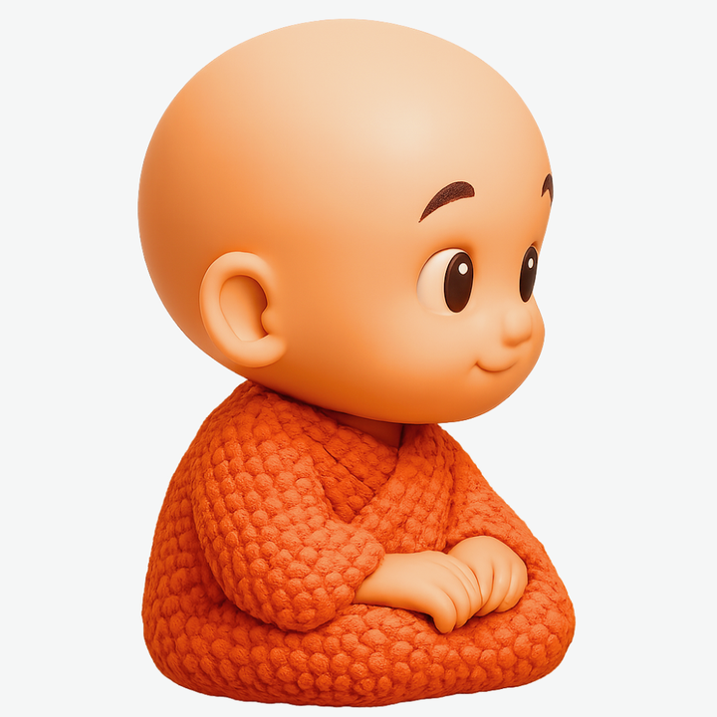
knodd.au 04
A wardrobe with room to grow
The simple pleasure of swapping
cut-out doll clothes, reimagined
for a little character.
An expandable wardrobe of colour, texture and outfit concepts. Garment samples will establish fit, fastening, fabric behaviour and production options.
Visual concepts only. No clothing range is on sale yet.
Notes:
Source: KNODD Living Branding Document v1.1, 13 January 2026. https://docs.google.com/document/d/1gcATUOFbaDA3XCJLDBvEaDbEUFzYdwd0/edit. Current founder instructions, 18 October 2026, supersede old brand relationship, fused-body architecture and palette. Original character and wordmark artwork supplied by founder. The paper-doll wardrobe reference comes from the founder’s current direct instruction. No fabric composition or garment availability is asserted. Current founder direction is an expandable wardrobe of colour, texture and outfit concepts. Collaboration possibilities are ideas only, with no agreements claimed.

Slide 5
knodd.au 05
Production choices
The product determines the material and production approach.
Character & outfits
Assess materials and manufacturing routes for the design.
Studio projects
Home and desk objects, gifts, keyrings and personalisation.
Optional 3D prints
Custom print enquiries where the design, process and licence fit.
Confirm production capability, materials, price and fulfilment for every project.
Notes:
Source: current founder correction,18 October 2026: KNODD is a broader character and clothing brand that can use manufacturing; the wardrobe tool leads and 3D printing is only an optional studio service. Earlier supplied studio branding documents inform optional portfolio directions. No manufacturer, factory, quotation, minimum order quantity, completed samples, rights or certification is assumed. The recovered business plan is an unfilled template, not evidence of operating results. Source workflow: earlier studio Business Plan Template VIC v0.1, document dated 7 January 2026, https://docs.google.com/document/d/1LpXzJ0Hr71qjzDXtNLg-oX_h07tAF2Ey/edit. An unfilled template is a planning aid, not evidence of completed production capability.

Slide 6
knodd.au 06
Product & manufacturing development
Each physical design needs evidence before it becomes an offer.
Character & clothing
Production & supply
Head-joint motion and retention
Garment fit and repeat changes
Fabric behaviour and colour stability
Assembly and care instructions
Material and process options
Potential manufacturing partners
Sample consistency and QC
Rights, suitability and fulfilment
All physical-product checks remain planned or need validation.
Notes:
Source: KNODD Living Branding Document v1.1, 13 January 2026. https://docs.google.com/document/d/1gcATUOFbaDA3XCJLDBvEaDbEUFzYdwd0/edit. Current founder instructions, 18 October 2026, supersede old brand relationship, fused-body architecture and palette. Original character and wordmark artwork supplied by founder. Development gates are original planning recommendations grounded in the founder’s requested product architecture and the business plan’s QA, IP and fulfilment workflow. They do not assert certification or completed tests.

Slide 7
knodd.au 07
The launch pathway
Progress follows completed checks, rather than an announced date.
01
Prepare
Keep original identity and the wardrobe tool clear.
02
Develop
Review processes, potential partners and physical samples.
03
Validate
Check the joint, garment fit, materials, safety and QC.
04
Confirm
Publish final specifications, price and fulfilment terms.
05
Release
Open a limited launch only after the earlier gates pass.
Original art and website preparation are evidenced. Product launch gates remain open.
Notes:
Source: KNODD Living Branding Document v1.1, 13 January 2026. https://docs.google.com/document/d/1gcATUOFbaDA3XCJLDBvEaDbEUFzYdwd0/edit. Current founder instructions, 18 October 2026, supersede old brand relationship, fused-body architecture and palette. Original character and wordmark artwork supplied by founder. See the companion product roadmap for individual gate evidence. No prototype or physical test completion is claimed.

Slide 8
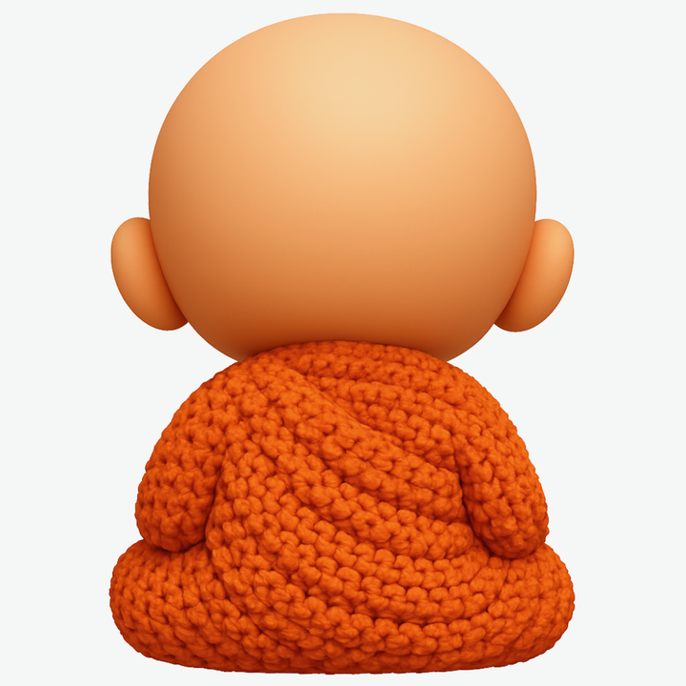
knodd.au 08
A little hello
A little character, with a look you can make your own.
Explore the wardrobe, share an outfit idea or ask a question. Final product details and availability are confirmed before ordering.
knodd.au
Future collaboration ideas would need separate agreements.
Notes:
Source: current founder correction,18 October 2026: KNODD is a broader character and clothing brand that can use manufacturing; the wardrobe tool leads and 3D printing is only an optional studio service. Earlier supplied studio branding documents inform optional portfolio directions. No manufacturer, factory, quotation, minimum order quantity, completed samples, rights or certification is assumed. The recovered business plan is an unfilled template, not evidence of operating results. Business identity verified on official ABN Lookup on 18 October 2026: KNODD is a registered business name of James-Anthony Gregory Giorlando, ABN 67 546 382 618. https://abr.business.gov.au/ABN/View?abn=67546382618. No supply agreement, investor ask or commercial partnership is asserted.

